Slide 1

Artist Analytics Project
Dylan Serino

Slide 2
Presentation Overview
1 Introduction
4 Dashboards
Project Outline
Plan
Sketches
Demos
2 Getting the Data
5 Limitations & Future Recs
Alteryx Flows
Alteryx Outputs
Limitations
Future Recommendations
3 Creating Tables
Schema
Snowflake SQL DDL/DML

Slide 3
Introduction

Slide 4

Outline
Simulating an artist management business looking to track their musicians’ performance and tour information.
Aim to answer main question of: Is each artist’s new album landing, and where/when should they tour next?
VP of Touring & Artists (Executive)
  AS A VP of Touring & Artists I NEED to see which artists are touring a new album and whether that album is carrying their shows SO I CAN decide where to allocate budget and attention
Touring & Artist Analyst
  AS A Touring & Artist Analyst I NEED TO break shows down by artist, tour, song, market SO I CAN figure out which songs to push, which cities to tour to next, and which venues to rebook

Slide 5
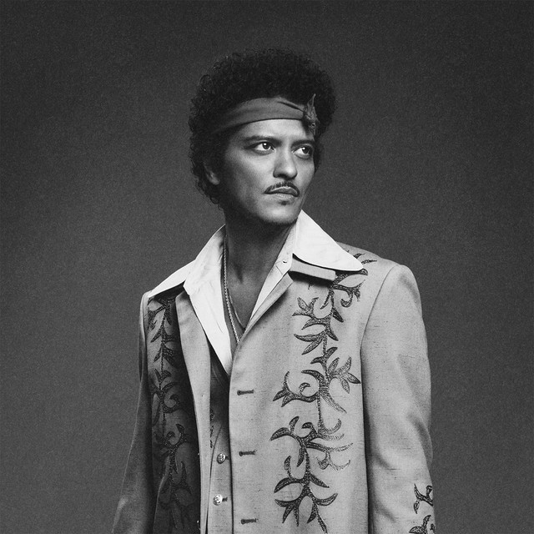




The Roster
Bruno Mars
Kendrick Lamar
Daniel Caesar
Mac DeMarco
Sabrina Carpenter

Slide 6




Tech Stack & Plan
Collect data from 2 APIs: setlist.fm for setlist data from concerts and MusicBrainz for artist, album, and song details
MusicBrainz uses an artist ID called ‘MBID’ which is exactly what key is used in setlist.fm for artists
Connect to Snowflake in Tableau to build out 2 dashboards for VP view and Analyst view
Connect to data in Snowflake, then clean, transform and create tables using SQL DDL/DML

Slide 7
Getting the Data

Slide 8
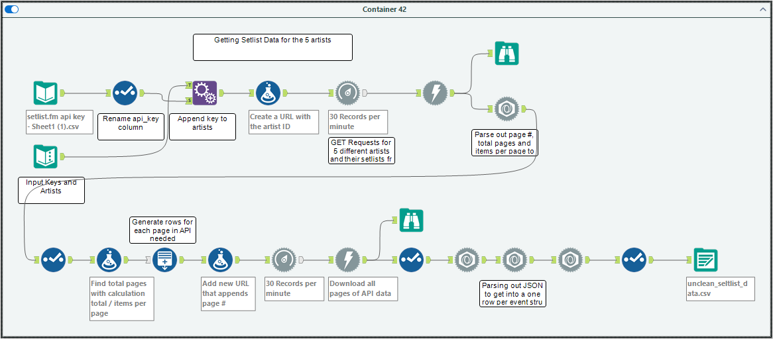
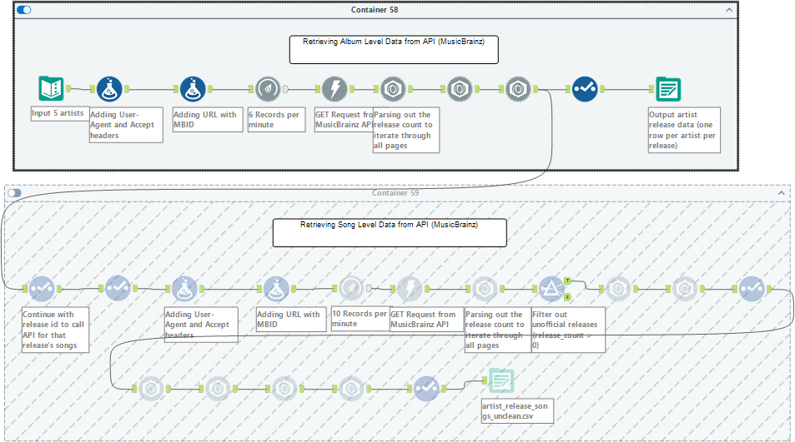
Alteryx Flows
setlist.fm required an API key, MusicBrainz did not
Required a ton of JSON parsing tools to fully unnest fields
Required a very low throttling rate for MusicBrainz (2-6/min) to guarantee no 429 or 503 errors (repeated this a lot)
Issue with Daniel Caesar and his albums

Slide 9

Output from Alteryx
3 Raw CSV files
Unclean_setlist_data from setlist.fm
Artist_releases_songs_unclean & artist_releases_unclean from MusicBrainz
Will then be cleaned in SQL

Slide 10
Building in Snowflake

Slide 11
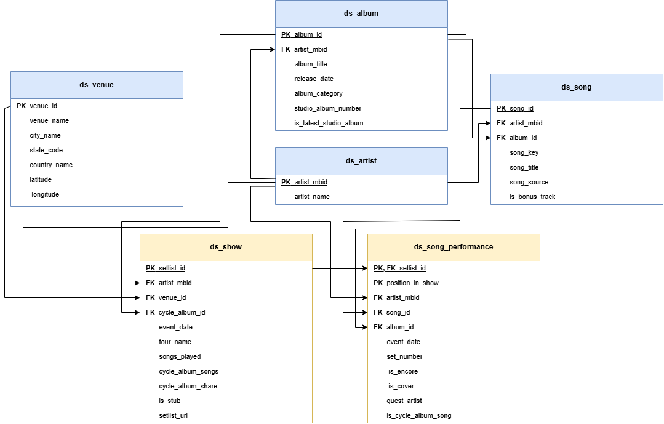
Schema

Slide 12
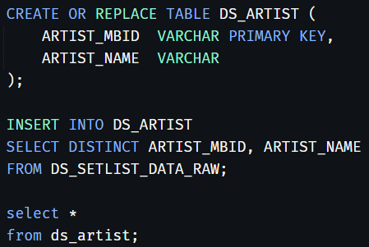
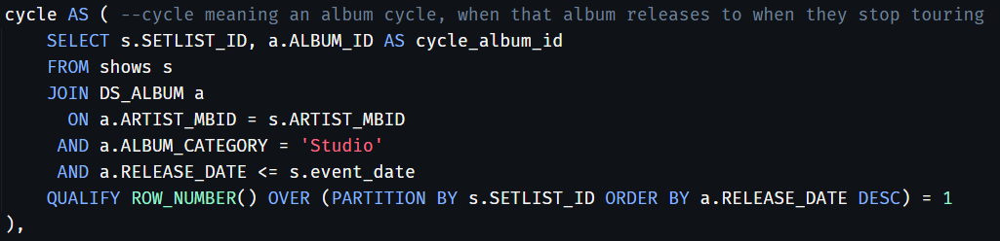
SQL DDL/DML Examples
Did most cleaning and transformation within SQL in order to input into tables
Defined what a cycle/cycle album is
  Artists most recent album, and cycle is the release to end of tour

Slide 13
Dashboard Sketches

Slide 14
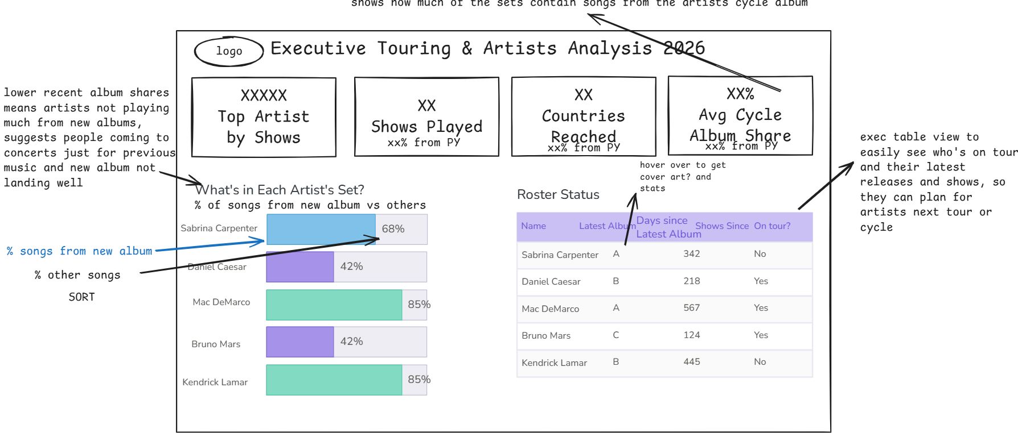
VP of Touring & Artists View

Slide 15
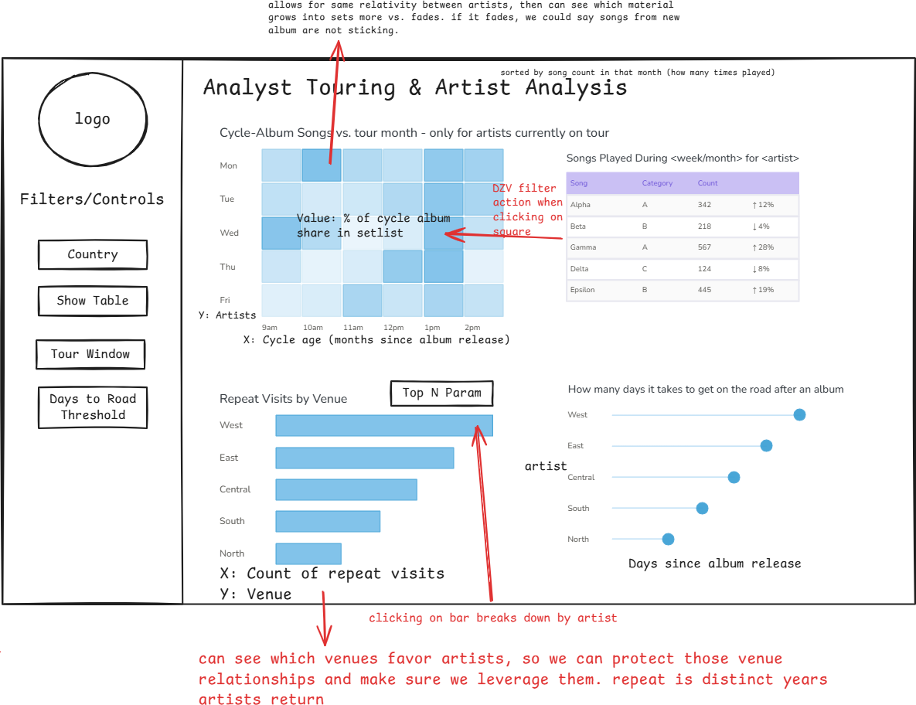
Touring & Artists Analyst View

Slide 16
Dashboard Demos

Slide 17
Limitations and Future Recommendations

Slide 18
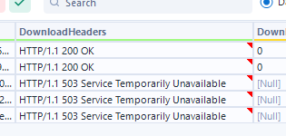
Limitations
Setlists are user-entered
  Lowered the matching rate between songs in the MusicBrainz API and the setlist.fm API (current match rate is about 75-85%)
  Missing data as well (e.g., missing data from Kendrick’s Grand National tour)
Throttling Rate
  For MusicBrainz, had to set a very low throttling rate (about 6 records/min) to be able to collect all rows without any 503 errors
Lots of Nested JSON
  Truncated cells which cut off needed characters, so had several JSON parse tools to completely parse out JSON so it was ready to be cleaned in SQL

Slide 19
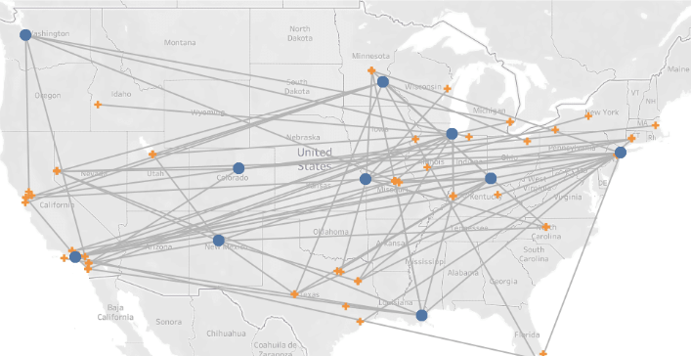
Future Recommendations
Incorporate financial metrics and demand data
  Would add ticket prices and amounts (maybe from TicketMaster API) and listener counts to supplement artist performance data
Touring Map
  Create a map using MAKELINE functions to show an artist’s tour path
  Can see if more efficient tour routing is possible
Add more artists!
  Kept the roster small for this project scope and Snowflake storage
  Could add more with just the MBID from earlier and ‘scale’ the company

